Slide 1

Smart Home Project
Members:
Fathy Mostafa Fathy
Mahmoud Ahmed Mahmoud
Yousef Tarek Mohamed
Mahmoud Ahmed Abdelhamid
Yousef Ahmed Abdel hakim
Amr Ahmed Reda

Slide 2

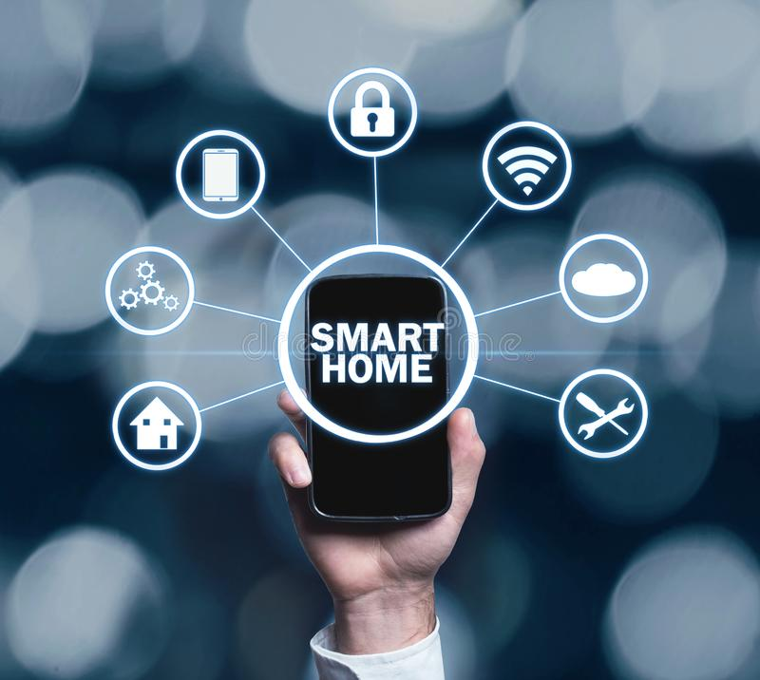
Introduction
What is a Smart Home?
A smart home is a home that is equipped with technology to remotely control and automate household systems like lighting, temperature, security and more.
The idea behind a smart home is to make life simpler and more enjoyable by having all of your devices connected and accessible from one central hub.
These features are accessed remotely by the Admin via their phone(s) via Bluetooth, or on-site by the users via the keypad..

Slide 3
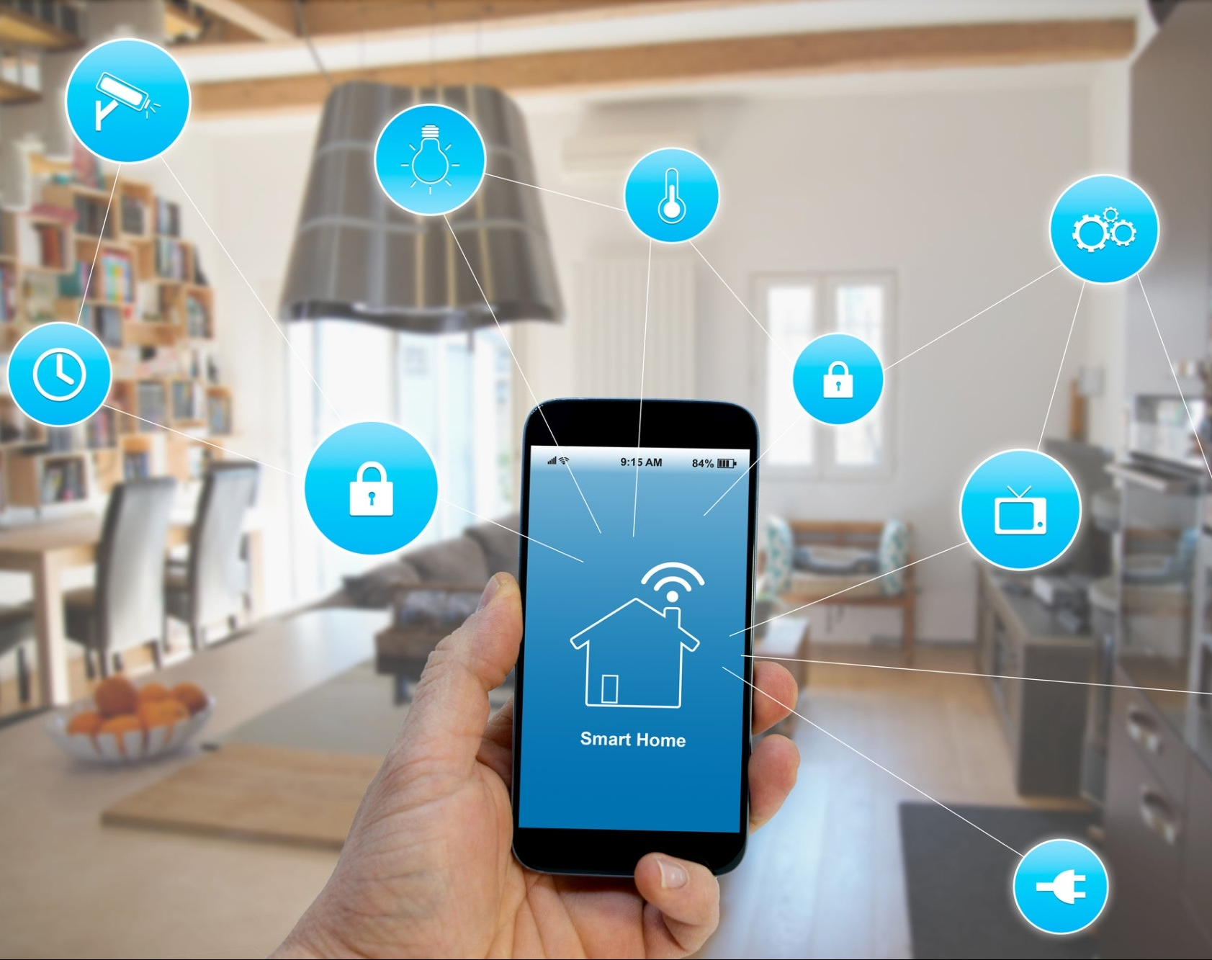
Technologies used
Software(s) Used:
Proteus Design Suite
SDK
Bluetooth Serial Controller(HC05)

Slide 4
Design and simulation Setup
Modules:
LCD:
Used as one of the key components for the login system and system control, its mostly only used by the users, it also displays the running devices in the background if it’s not used by the user
Keypad:
Used by the user to both log in and interact with the system, therefore it acts as the control hub of the system.
Relay: A relay is a device that responds to a small current or voltage change by activating a switches or other devices. Used to remotely switch signals or power
Bluetooth: Is used for establishing a connection between the system and the admin’s phone for system access and controls.
EEPROM : is used for storing data for users and admin and storing new users .

Slide 5
Design and simulation setup cont.
AC Controller: Is turned on/off based on the temperature sensor’s readings.
Temperature Sensor: Temperature sensor reads the ambient temperature, if the temperature is higher than 28°C, Air condition must be run “DC motor”, if the temperature becomes lower than 21°C, Air condition must be turned off “DC motor”.
Alarm: Is a security measure that’s triggered upon multiple false login entries.
Lamps: Lamps are isolated because of high power.
Door Controller: The actuator used is a servo motor to control the opening door only in admin mode, it is controlled by command which is send by Mobile/PC “Open Close the door”.
Dimmer lamp :it allows to change their brightens by admin or user (pulse width modulation )

Slide 6

Simulation

Slide 7
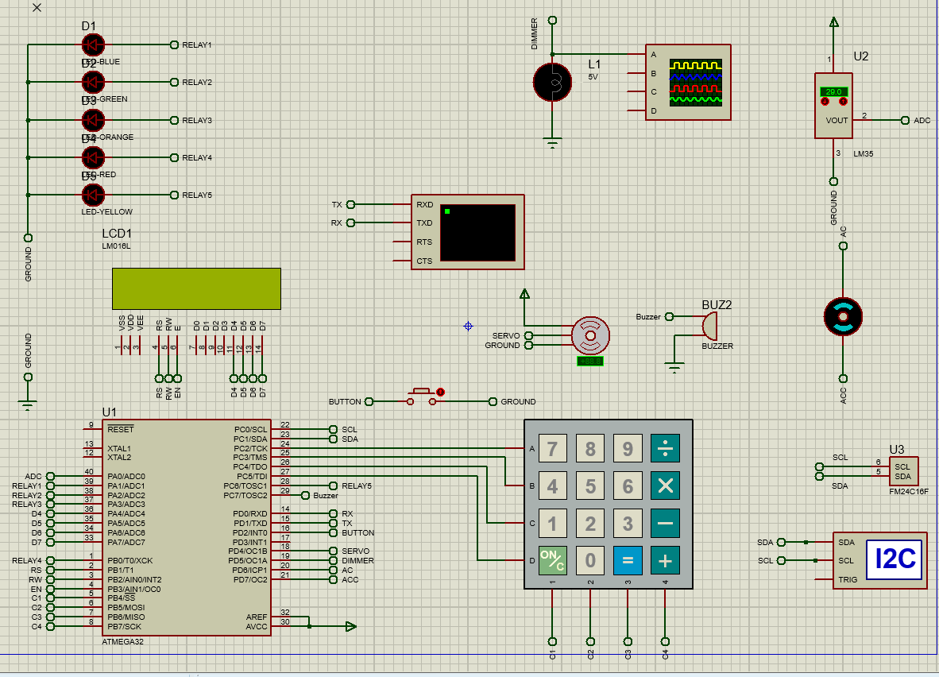

Slide 8

conclusion
A smart home can make your life simpler and more enjoyable by allowing you to control your devices from one central hub. It can also save you time and money, as well as increase your security. When setting up a smart home, it is important to consider security and make sure that your devices are password protected and that your network is secure.

Slide 9
Any Questions?

